Slide 1
ZOMATO DATA ANALYSIS PROJECT
SANGRAM KESHARI MOHAPATRA

Slide 2
LINK FOR THE DATASET
PLEASE DOUBLE CLICK ON THE LINK FILE AND IT WILL TAKE TO THE DATASET FILE

Slide 3
name | online_order | book_table | rate | votes | approx_cost(for two people) | listed_in(type)
Jalsa | Yes | Yes | 4.1 | 775 | 800 | Buffet
Spice Elephant | Yes | No | 4.1 | 787 | 800 | Buffet
San Churro Cafe | Yes | No | 3.8 | 918 | 800 | Buffet
Timepass Dinner | Yes | No | 3.8 | 286 | 600 | Buffet
Onesta | Yes | Yes | 4.6 | 2556 | 600 | Cafes
Penthouse Cafe | Yes | No | 4 | 324 | 700 | Other
Smacznego | Yes | No | 4.2 | 504 | 550 | Cafes
Village CafÃ© | Yes | No | 4.1 | 402 | 500 | Cafes
Cafe Shuffle | Yes | Yes | 4.2 | 150 | 600 | Cafes
The Coffee Shack | Yes | Yes | 4.2 | 164 | 500 | Cafes
San Churro Cafe | Yes | No | 3.8 | 918 | 800 | Cafes
Cafe Vivacity | Yes | No | 3.8 | 90 | 650 | Cafes
Catch-up-ino | Yes | No | 3.9 | 133 | 800 | Cafes
Kirthi's Biryani | Yes | No | 3.8 | 144 | 700 | Cafes
oms Restaurant An | Yes | No | 3.1 | 13 | 400 | Cafes
The Vintage Cafe | Yes | No | 3 | 62 | 400 | Cafes
Woodee Pizza | Yes | No | 3.7 | 180 | 500 | Cafes
My Tea House | Yes | No | 3.6 | 62 | 600 | Cafes
Coffee Tindi | Yes | No | 3.8 | 75 | 200 | Cafes
Redberrys | Yes | No | 4 | 219 | 600 | Cafes
Foodiction | Yes | No | 2.8 | 506 | 500 | other
Sweet Truth | Yes | No | 3.9 | 35 | 500 | Dining
Ovenstory Pizza | Yes | No | 3.9 | 172 | 750 | Dining
Faasos | Yes | No | 4.2 | 415 | 500 | other
Behrouz Biryani | Yes | No | 3.9 | 230 | 650 | Dining
Fast And Fresh | Yes | No | 2.8 | 91 | 400 | Dining
Szechuan Dragon | Yes | No | 4.2 | 1647 | 600 | Dining
Empire Restaurant | Yes | No | 4.4 | 4884 | 750 | other
hi Davangere Benn | Yes | No | 4 | 17 | 150 | Dining
Chaatimes | Yes | No | 3.8 | 133 | 200 | Dining
McDonald's | Yes | No | 3.9 | 286 | 500 | Dining
Domino's Pizza | Yes | No | 3.9 | 540 | 800 | Dining
Onesta | Yes | Yes | 4.6 | 2556 | 600 | other
Kitchen Garden | Yes | No | 3.6 | 244 | 300 | Dining
Recipe | Yes | No | 4 | 804 | 450 | Dining
Beijing Bites | Yes | No | 3.7 | 679 | 850 | Dining
Tasty Bytes | Yes | No | 3.1 | 245 | 300 | Dining
Shree Cool Point | Yes | No | 4.1 | 28 | 150 | Dining
Biryanis And More | Yes | No | 4 | 618 | 750 | Dining
FreshMenu | Yes | No | 3.9 | 627 | 450 | Dining
shankari Donne Bir | Yes | No | 3.8 | 104 | 300 | Dining
Wamama | Yes | Yes | 4.2 | 354 | 800 | other
XO Belgian Waffle | Yes | No | 3.7 | 17 | 400 | Dining
Goa 0 Km | Yes | Yes | 3.6 | 163 | 800 | Dining
Chinese Kitchen | Yes | No | 3.8 | 58 | 150 | Dining
Kabab Magic | Yes | No | 4.1 | 1720 | 400 | Dining
amma Brahmin's Id | Yes | No | 3.6 | 34 | 100 | Dining
Burger King | Yes | No | 3.2 | 71 | 600 | Dining
The Good Bowl | Yes | No | 3.6 | 6 | 500 | Dining
reshwara Davange | Yes | No | 4.1 | 558 | 150 | Dining
nna Dum Biriyani C | Yes | No | 3.6 | 28 | 300 | Dining
lu Sea Food Restau | Yes | No | 3.8 | 153 | 500 | Dining
Frozen Bottle | Yes | No | 4.2 | 146 | 400 | Dining
Meghana Foods | Yes | No | 4.4 | 4401 | 600 | Dining
Polar Bear | Yes | No | 3.8 | 71 | 400 | Dining
ngaluru Coffee Hou | Yes | No | 4.1 | 201 | 300 | Dining
Anna Kuteera | Yes | No | 4 | 771 | 450 | Dining
Vijayalakshmi | Yes | No | 3.9 | 47 | 200 | Dining

Slide 4
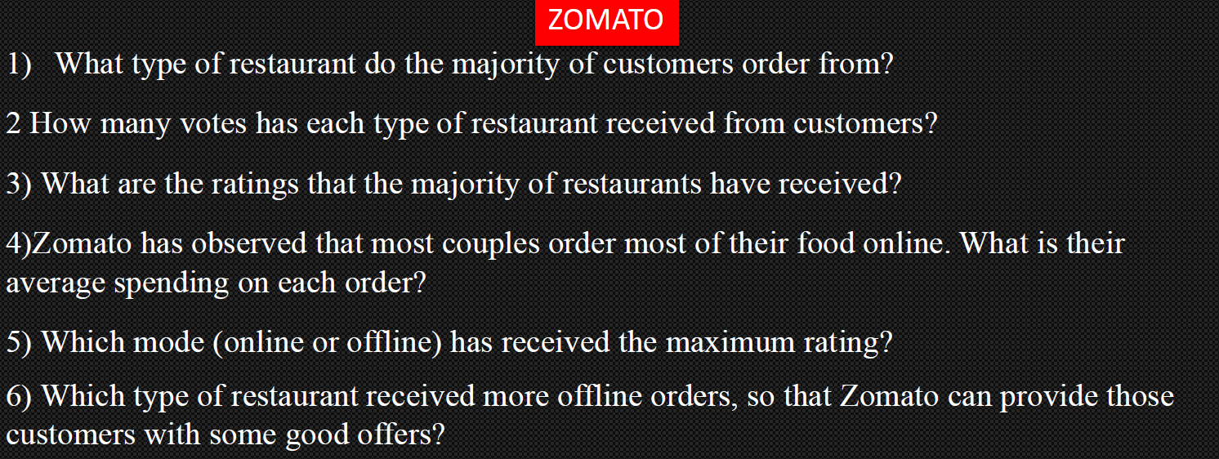

Slide 5
NO OF RESTAURANTS | Count of online order
Buffet | 7
Cafes | 23
Dining | 110
other | 8
Grand Total | 148

Slide 6
It is clearly seen that most of the customers prefer the Dining restaurant

Slide 7
TYPE OF RESTAURANTS | SUM OF VOTES
Buffet | 3028
Cafes | 6434
Dining | 20363
other | 9367
Grand Total | 39192

Slide 8
The Dining restaurant has the greatest number of votes amongst all restaurants

Slide 9
RATINGS | Sum of rate
2.6 | 2.6
2.8 | 5.6
2.9 | 20.3
3 | 6
3.1 | 21.7
3.2 | 22.4
3.3 | 46.2
3.4 | 40.8
3.5 | 21
3.6 | 39.6
3.7 | 55.5
3.8 | 76
3.9 | 39
4 | 40
4.1 | 45.1
4.2 | 33.6
4.3 | 4.3
4.4 | 8.8
4.6 | 9.2
Grand Total | 537.7

Slide 10
MOST OF THE RATINGS RECEIVED BY THE RESTAURANTS ARE 3.7 AND 3.8

Slide 11
APPROX COST | COUNT OF APPROX_COST(FOR TWO PEOPLE)
100 | 6
150 | 16
200 | 16
250 | 6
300 | 23
350 | 3
400 | 15
450 | 6
500 | 14
550 | 3
600 | 13
650 | 2
700 | 5
750 | 3
800 | 12
850 | 2
900 | 2
950 | 1
Grand Total | 148

Slide 12
APPROX COST FOR MOST COUPLES IS 300

Slide 13
COUNT OF RATE | MODE OF ORDER
RATINGS | OFFLINE(NO) | ONLINE(YES) | Grand Total
2.6 | 1 |  | 1
2.8 |  | 2 | 2
2.9 | 7 |  | 7
3 | 1 | 1 | 2
3.1 | 5 | 2 | 7
3.2 | 6 | 1 | 7
3.3 | 14 |  | 14
3.4 | 12 |  | 12
3.5 | 6 |  | 6
3.6 | 5 | 6 | 11
3.7 | 12 | 3 | 15
3.8 | 9 | 11 | 20
3.9 | 2 | 8 | 10
4 | 4 | 6 | 10
4.1 | 4 | 7 | 11
4.2 | 1 | 7 | 8
4.3 | 1 |  | 1
4.4 |  | 2 | 2
4.6 |  | 2 | 2
Grand Total | 90 | 58 | 148

Slide 14
CLEARLY SEEN THAT THE ONLINE ORDER HAS THE HIGHEST RATINGS AS COMPARED TO OFFLINE
HERE ONLINE DENOTES "YES" AND OFFLINE DENOTES "NO"

Slide 15
LINK TO THE WHOLE EXCEL FILE
PLEASE DOUBLE CLICK ON THE LINK FILE AND IT WILL TAKE TO THE EXCEL FILE

Slide 16


